Slide 1

Minimum Edit Distance
Definition of Minimum Edit Distance

Slide 2
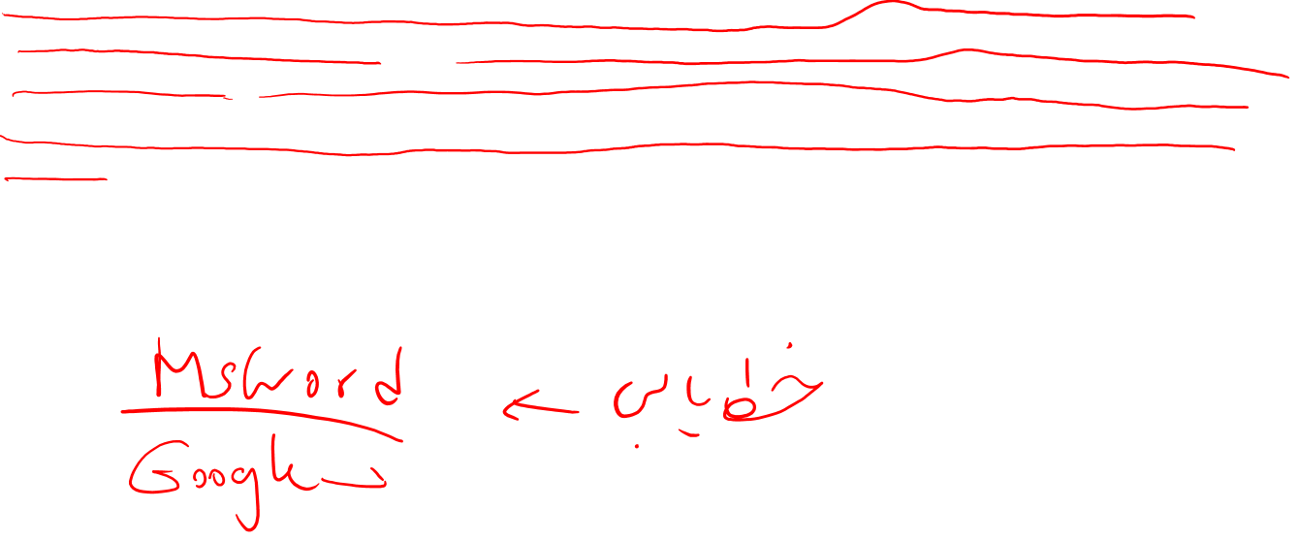
Who cares about spelling?
Aoccdrnig to a rscheearch at Cmabrigde Uinervtisy, it deosn’t mttaer in waht oredr the ltteers in a wrod are, the olny iprmoetnt tihng is taht the frist and lsat ltteer be at the rghit pclae. The rset can be a toatl mses and you can sitll raed it wouthit porbelm. Tihs is bcuseae the huamn mnid deos not raed ervey lteter by istlef, but the wrod as a wlohe.
(See http://www.mrc-cbu.cam.ac.uk/personal/matt.davis/Cmabrigde/ for the story behind this supposed research report.)

Slide 3
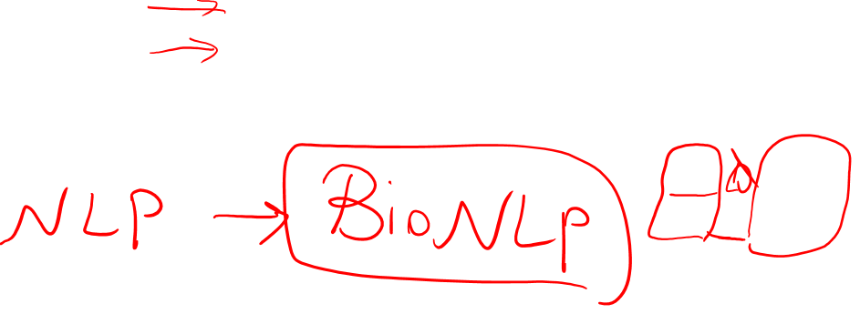
How similar are two strings?
Spell correction
The user typed “graffe”
Which is closest?
graf
graft
grail
giraffe
Computational Biology
Align two sequences of nucleotides
Resulting alignment:
AGGCTATCACCTGACCTCCAGGCCGATGCCC
TAGCTATCACGACCGCGGTCGATTTGCCCGAC
-AGGCTATCACCTGACCTCCAGGCCGA--TGCCC---
TAG-CTATCAC--GACCGC--GGTCGATTTGCCCGAC
Also for Machine Translation, Information Extraction, Speech Recognition

Slide 4
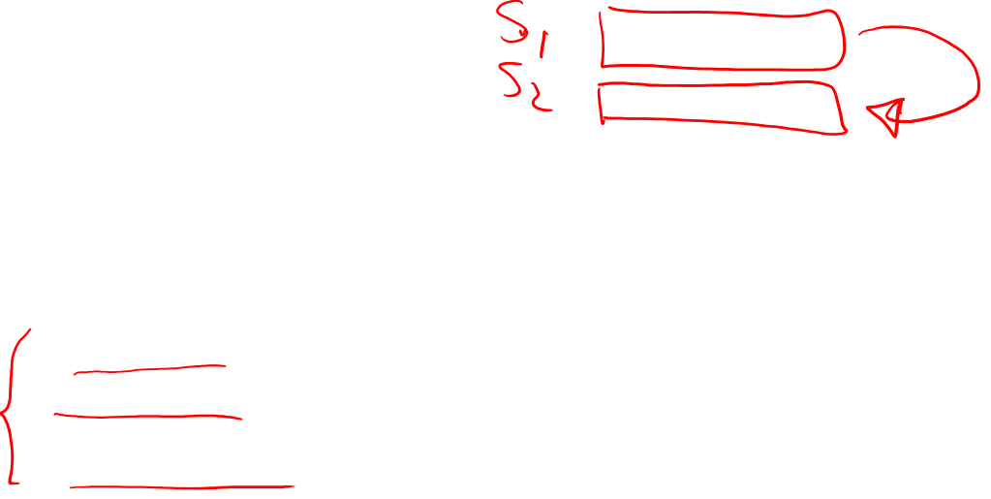
Edit Distance
The minimum edit distance between two strings
Is the minimum number of editing operations
Insertion
Deletion
Substitution
Needed to transform one into the other

Slide 5

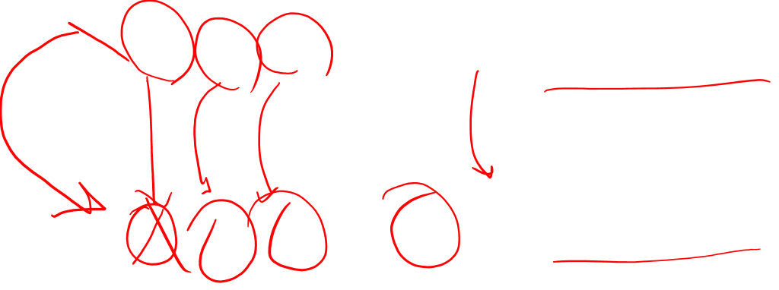
Minimum Edit Distance
Two strings and their alignment:

Slide 6
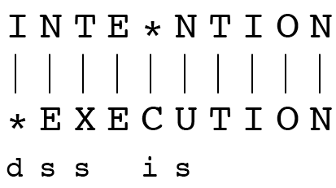
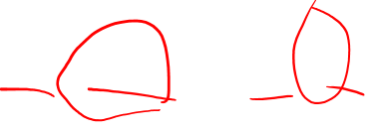
Minimum Edit Distance
If each operation has cost of 1
Distance between these is 5
If substitutions cost 2 (Levenshtein)
Distance between them is 8

Slide 7
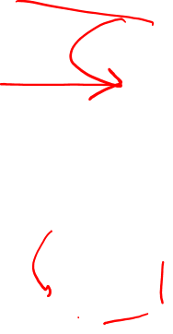
Alignment in Computational Biology
Given a sequence of bases
An alignment:
Given two sequences, align each letter to a letter or gap
AGGCTATCACCTGACCTCCAGGCCGATGCCC
TAGCTATCACGACCGCGGTCGATTTGCCCGAC
-AGGCTATCACCTGACCTCCAGGCCGA--TGCCC---
TAG-CTATCAC--GACCGC--GGTCGATTTGCCCGAC

Slide 8
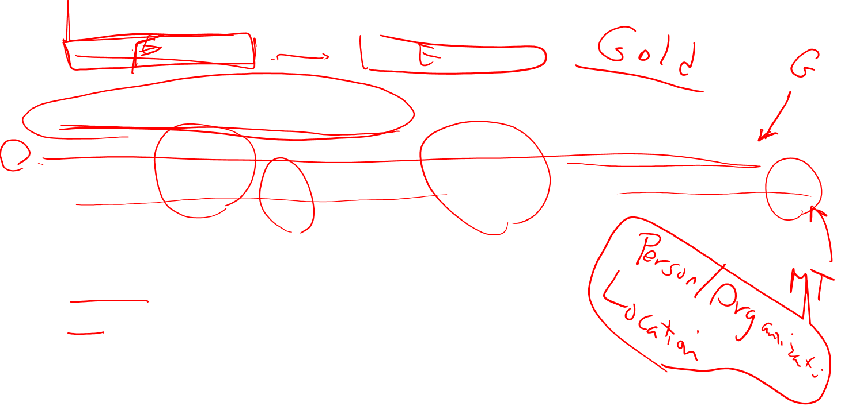
Other uses of Edit Distance in NLP
Evaluating Machine Translation and speech recognition
R Spokesman confirms senior government adviser was shot
H Spokesman said the senior adviser was shot dead
S I D I
Named Entity Extraction and Entity Coreference
IBM Inc. announced today
IBM profits
Stanford President John Hennessy announced yesterday
for Stanford University President John Hennessy

Slide 9
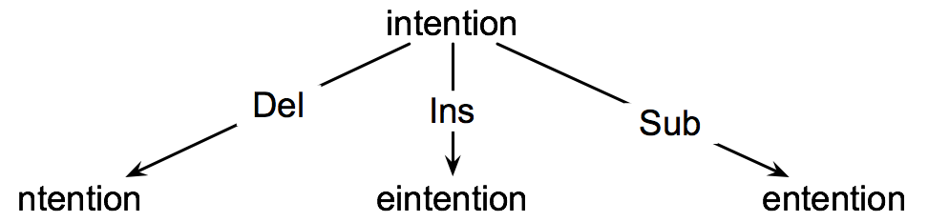
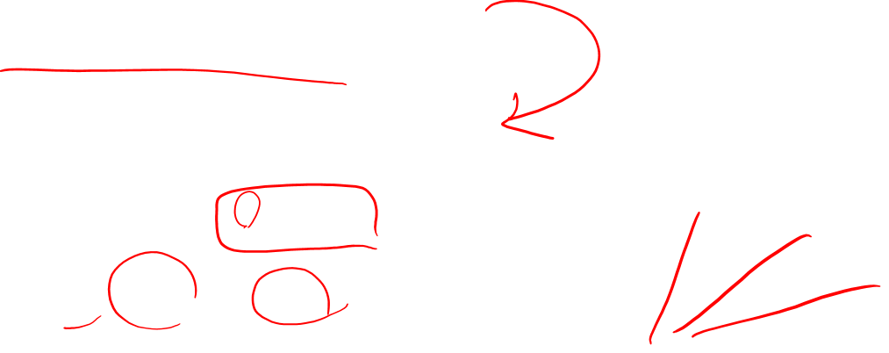
How to find the Min Edit Distance?
Searching for a path (sequence of edits) from the start string to the final string:
Initial state: the word we’re transforming
Operators: insert, delete, substitute
Goal state: the word we’re trying to get to
Path cost: what we want to minimize: the number of edits

Slide 10
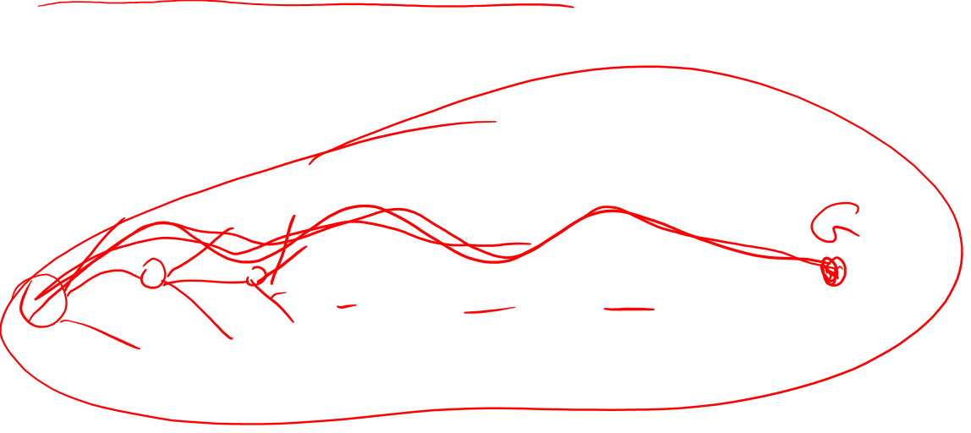
Minimum Edit as Search
But the space of all edit sequences is huge!
We can’t afford to navigate naïvely
Lots of distinct paths wind up at the same state.
We don’t have to keep track of all of them
Just the shortest path to each of those revisted states.

Slide 11
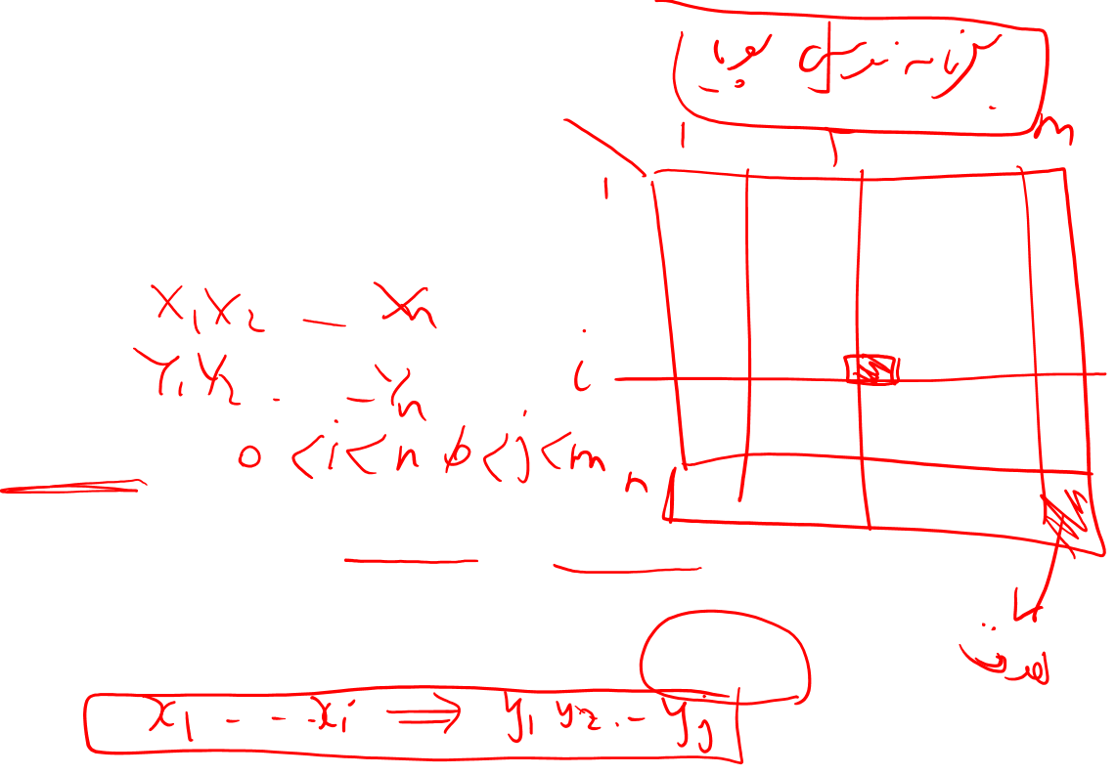
Defining Min Edit Distance
For two strings
X of length n
Y of length m
We define D(i,j)
the edit distance between X[1..i] and Y[1..j]
i.e., the first i characters of X and the first j characters of Y
The edit distance between X and Y is thus D(n,m)

Slide 12
Minimum Edit Distance
Definition of Minimum Edit Distance

Slide 13
Minimum Edit Distance
Computing Minimum Edit Distance

Slide 14
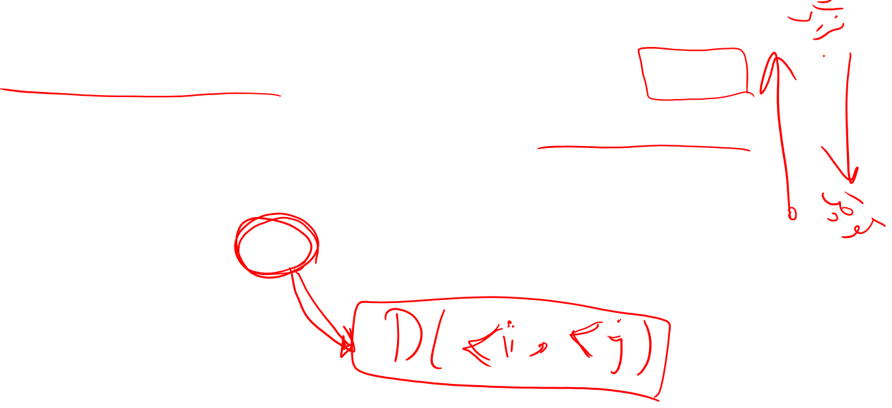
Dynamic Programming for Minimum Edit Distance
Dynamic programming: A tabular computation of D(n,m)
Solving problems by combining solutions to subproblems.
Bottom-up
We compute D(i,j) for small i,j
And compute larger D(i,j) based on previously computed smaller values
i.e., compute D(i,j) for all i (0 < i < n) and j (0 < j < m)

Slide 15
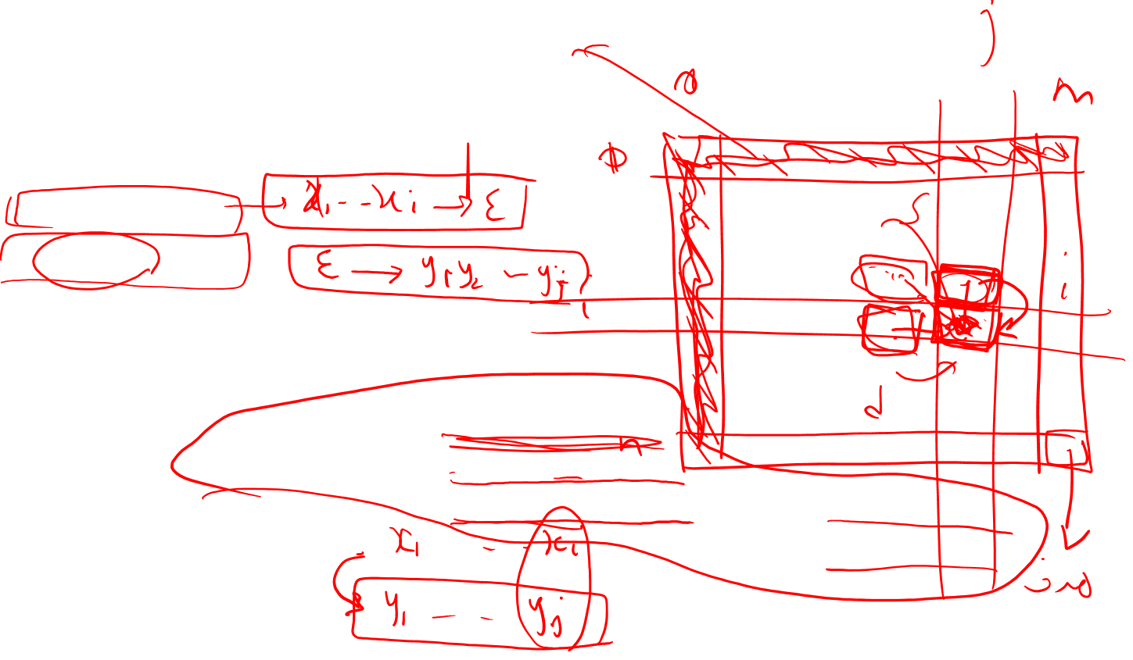
Defining Min Edit Distance (Levenshtein)
Initialization
D(i,0) = i
D(0,j) = j
Recurrence Relation:
For each i = 1…M
For each j = 1…N
D(i-1,j) + 1
D(i,j)= min D(i,j-1) + 1
D(i-1,j-1) + 2; if X(i) ≠ Y(j)
0; if X(i) = Y(j)
Termination:
D(N,M) is distance

Slide 16
The Edit Distance Table
N | 9
O | 8
I | 7
T | 6
N | 5
E | 4
T | 3
N | 2
I | 1
# | 0 | 1 | 2 | 3 | 4 | 5 | 6 | 7 | 8 | 9
 | # | E | X | E | C | U | T | I | O | N

Slide 17
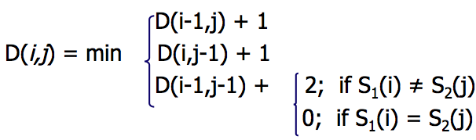
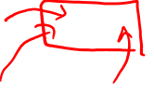
The Edit Distance Table
N | 9
O | 8
I | 7
T | 6
N | 5
E | 4
T | 3
N | 2
I | 1
# | 0 | 1 | 2 | 3 | 4 | 5 | 6 | 7 | 8 | 9
 | # | E | X | E | C | U | T | I | O | N

Slide 18
Edit Distance
N | 9
O | 8
I | 7
T | 6
N | 5
E | 4
T | 3
N | 2
I | 1
# | 0 | 1 | 2 | 3 | 4 | 5 | 6 | 7 | 8 | 9
 | # | E | X | E | C | U | T | I | O | N

Slide 19
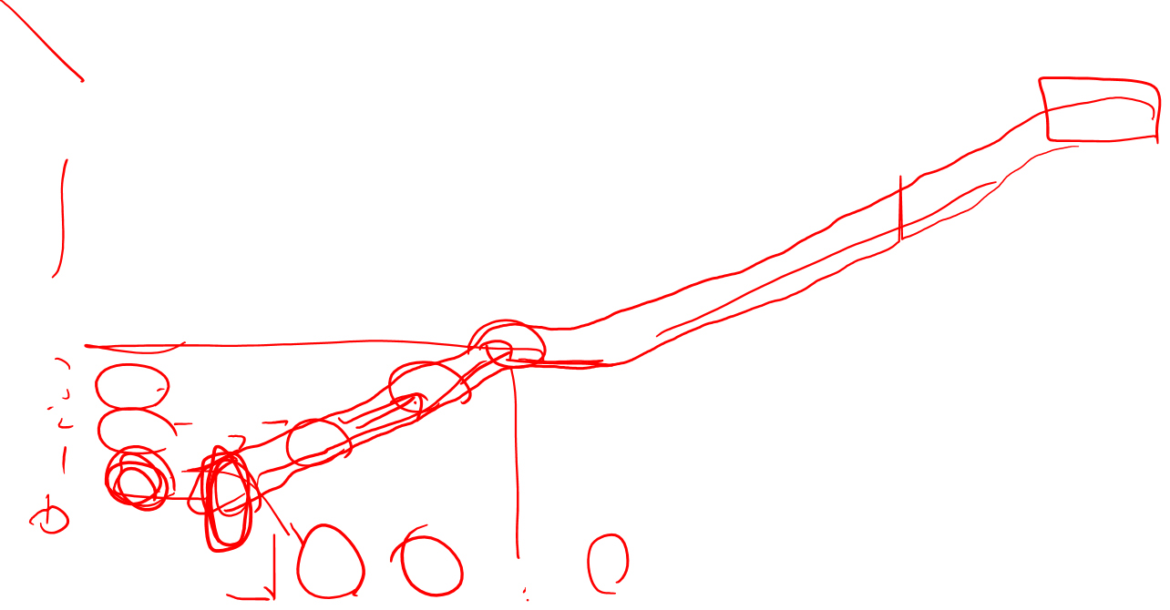
The Edit Distance Table
N | 9 | 8 | 9 | 10 | 11 | 12 | 11 | 10 | 9 | 8
O | 8 | 7 | 8 | 9 | 10 | 11 | 10 | 9 | 8 | 9
I | 7 | 6 | 7 | 8 | 9 | 10 | 9 | 8 | 9 | 10
T | 6 | 5 | 6 | 7 | 8 | 9 | 8 | 9 | 10 | 11
N | 5 | 4 | 5 | 6 | 7 | 8 | 9 | 10 | 11 | 10
E | 4 | 3 | 4 | 5 | 6 | 7 | 8 | 9 | 10 | 9
T | 3 | 4 | 5 | 6 | 7 | 8 | 7 | 8 | 9 | 8
N | 2 | 3 | 4 | 5 | 6 | 7 | 8 | 7 | 8 | 7
I | 1 | 2 | 3 | 4 | 5 | 6 | 7 | 6 | 7 | 8
# | 0 | 1 | 2 | 3 | 4 | 5 | 6 | 7 | 8 | 9
 | # | E | X | E | C | U | T | I | O | N

Slide 20
Minimum Edit Distance
Computing Minimum Edit Distance

Slide 21
Minimum Edit Distance
Backtrace for Computing Alignments

Slide 22
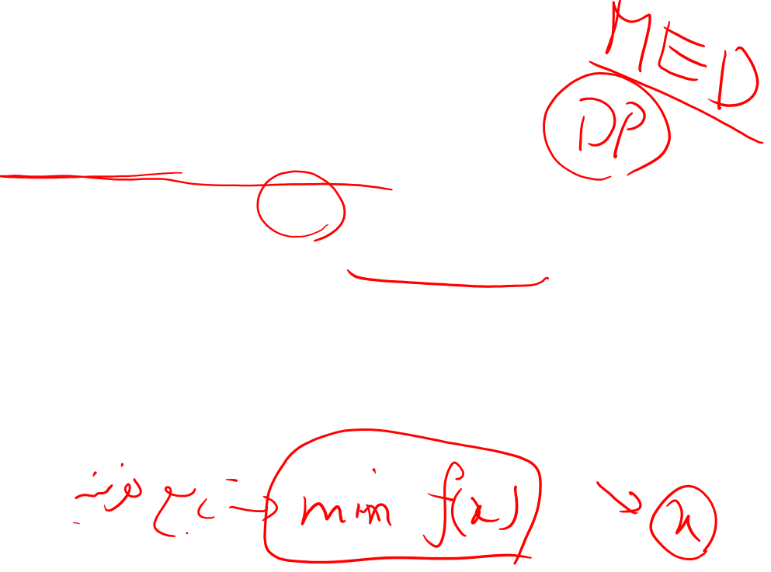
Computing alignments
Edit distance isn’t sufficient
We often need to align each character of the two strings to each other
We do this by keeping a “backtrace”
Every time we enter a cell, remember where we came from
When we reach the end,
Trace back the path from the upper right corner to read off the alignment

Slide 23
Edit Distance
N | 9
O | 8
I | 7
T | 6
N | 5
E | 4
T | 3
N | 2
I | 1
# | 0 | 1 | 2 | 3 | 4 | 5 | 6 | 7 | 8 | 9
 | # | E | X | E | C | U | T | I | O | N

Slide 24
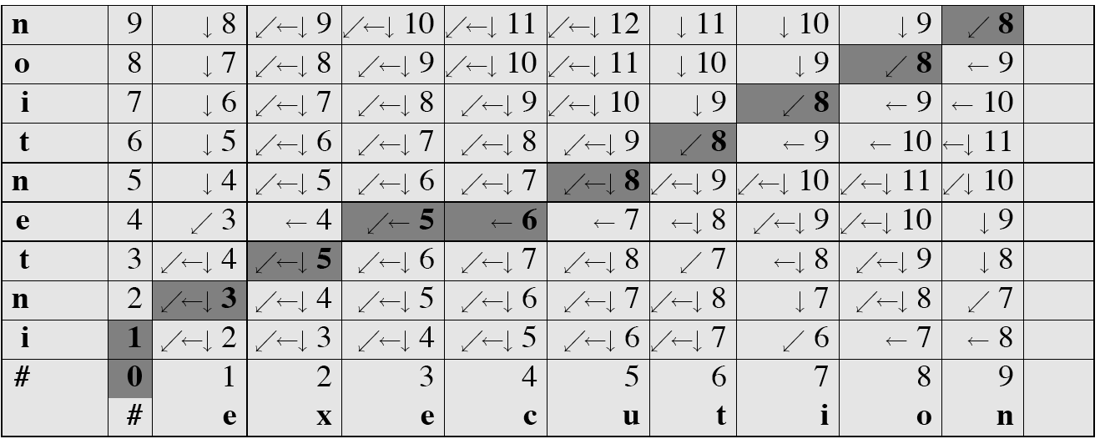
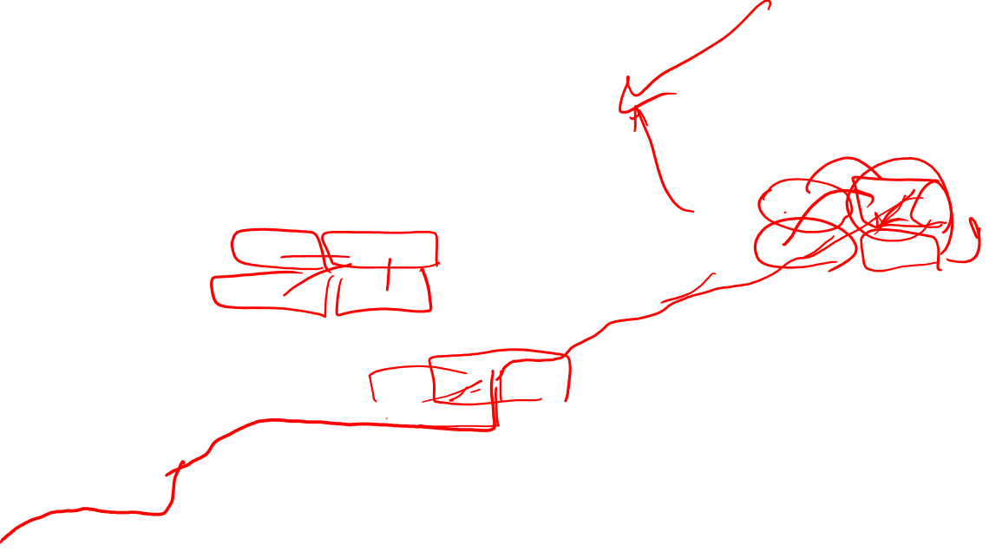
MinEdit with Backtrace

Slide 25
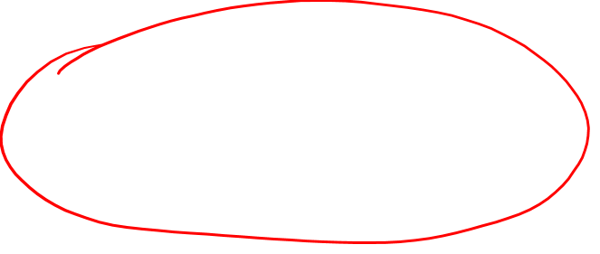
Adding Backtrace to Minimum Edit Distance
Base conditions: Termination:
D(i,0) = i D(0,j) = j D(N,M) is distance
Recurrence Relation:
For each i = 1…M
For each j = 1…N
D(i-1,j) + 1
D(i,j)= min D(i,j-1) + 1
D(i-1,j-1) + 2; if X(i) ≠ Y(j)
0; if X(i) = Y(j)
LEFT
ptr(i,j)= DOWN
DIAG
deletion
insertion
substitution
insertion
deletion
substitution

Slide 26
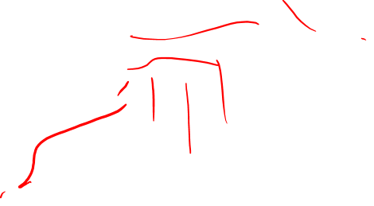
The Distance Matrix
Every non-decreasing path
from (0,0) to (M, N)
corresponds to
an alignment
of the two sequences
x₀ …………………… x_{N}
An optimal alignment is composed of optimal subalignments
y₀ ……………………………… y_{M}

Slide 27
Result of Backtrace
Two strings and their alignment:

Slide 28
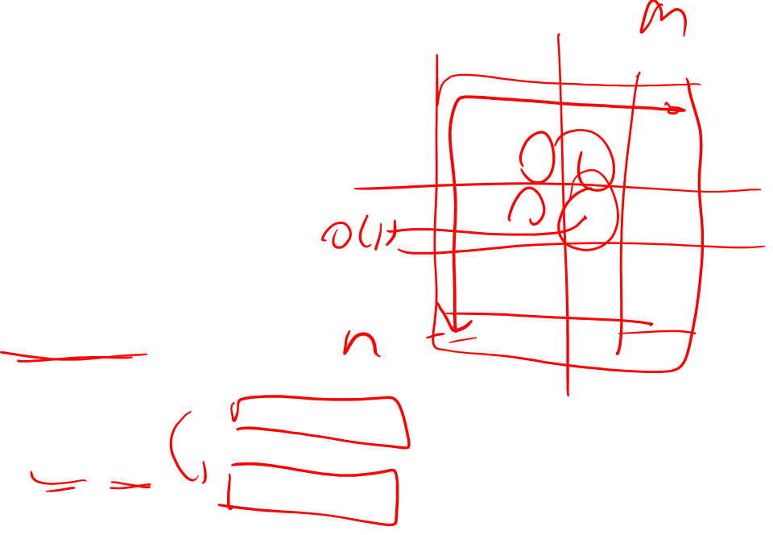
Performance
Time:
O(nm)
Space:
O(nm)
Backtrace
O(n+m)

Slide 29
Minimum Edit Distance
Backtrace for Computing Alignments

Slide 30
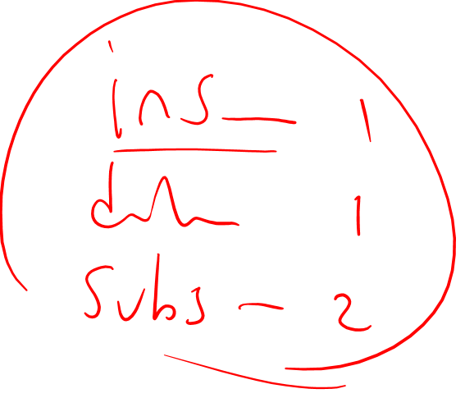
Minimum Edit Distance
Weighted Minimum Edit Distance

Slide 31
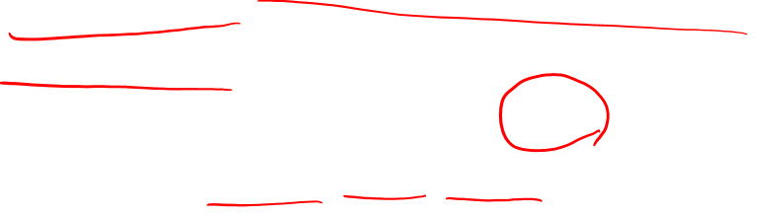
Detection vs. Correction in Spell Checking
There are two distinct tasks:
error detection = simply find the misspelled words
error correction = correct the misspelled words
e.g., It might be easy to tell that ater is a misspelled word, but what is the correct word? water? later? after?
So, what causes errors?

Slide 32
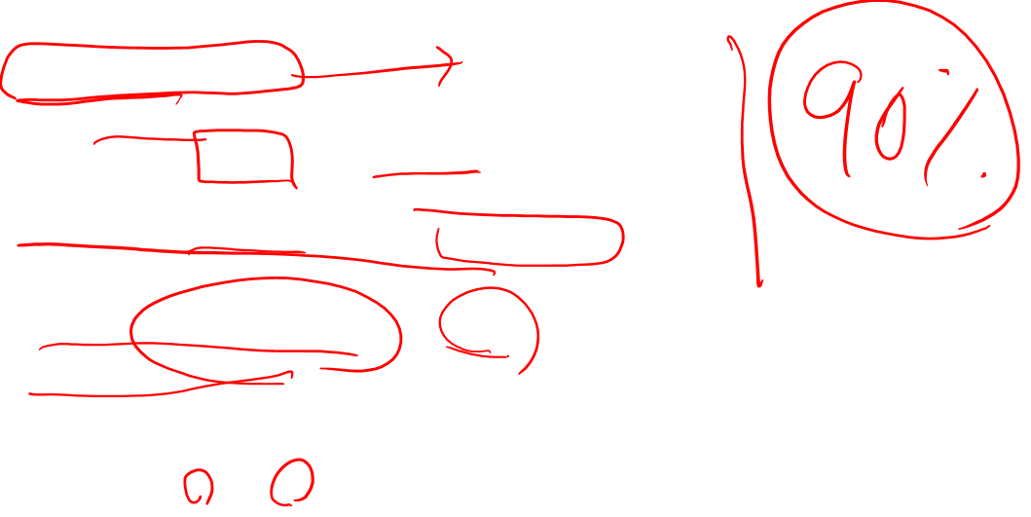
Keyboard mistyping
Space bar issues
run-on errors = two separate words become one
e.g., the fuzz becomes thefuzz
split errors = one word becomes two separate words
e.g., equalization becomes equali zation
Keyboard proximity
e.g., Jack becomes Hack since h, j are next to each other on a typical American keyboard
Physical similarity
similarity of shape, e.g., mistaking two physically similar letters when typing up something handwritten
e.g., tight for fight

Slide 33
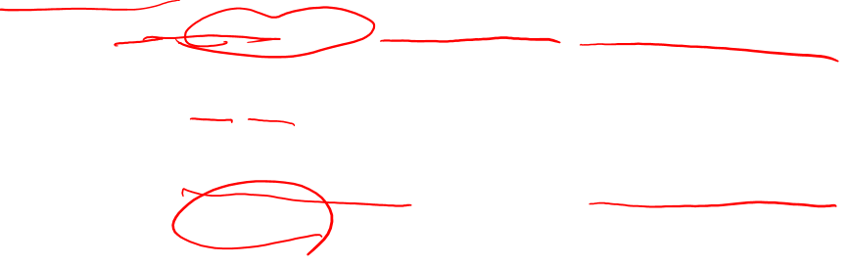
Phonetic errors
phonetic errors = errors based on the sounds of a language (not necessarily on the letters)
homophones = two words which sound the same
e.g., red/ read (past tense), cite/ site/ sight, they’re/ their/ there
Spoonerisms = switching two letters/sounds around
e.g., It’s a ravy(vary) grain with biscuit wheels.
letter substitution = replacing a letter (or sequence of letters) with a similar-sounding one
e.g., John kracked his nuckles. instead of John cracked his knuckles
e.g., I study sikologee.

Slide 34
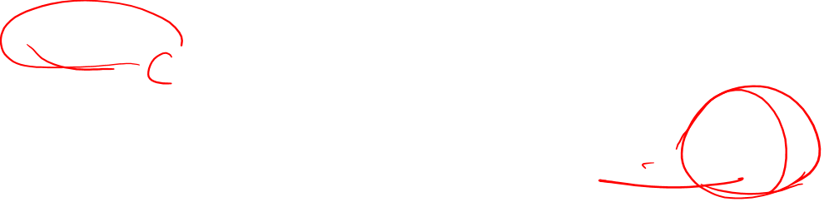
Knowledge problems
And then there are simply cases of not knowing how to spell:
not knowing a word and guessing its spelling (can be phonetic)
e.g., sientist
not knowing a rule and guessing it
e.g., Do we double a consonant for ing words? Jog -> joging ?

Slide 35
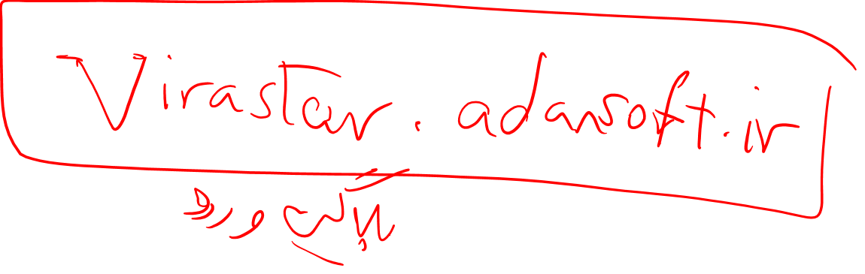
Weighted Edit Distance
Why would we add weights to the computation?
Spell Correction: some letters are more likely to be mistyped than others
Biology: certain kinds of deletions or insertions are more likely than others

Slide 36
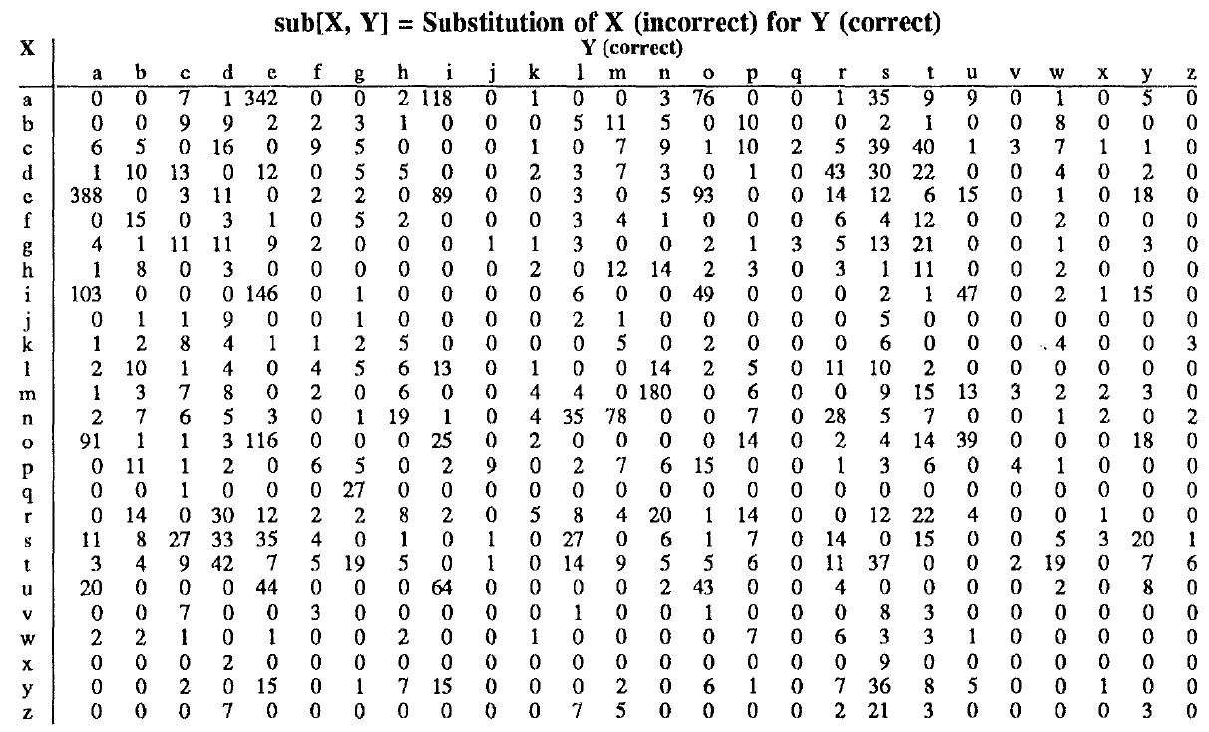
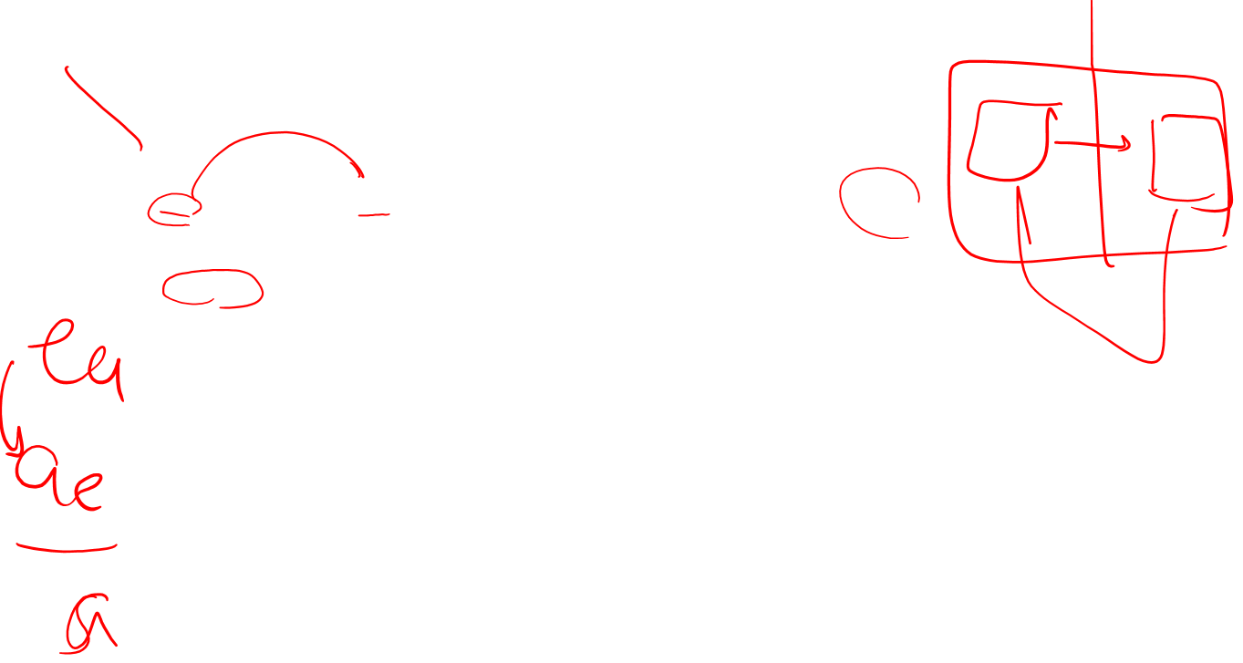
Confusion matrix for spelling errors

Slide 37
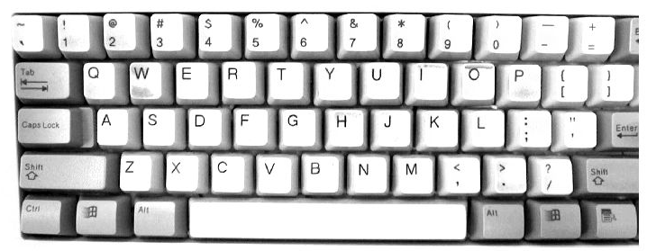
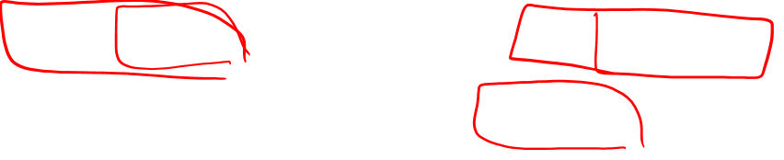

Slide 38
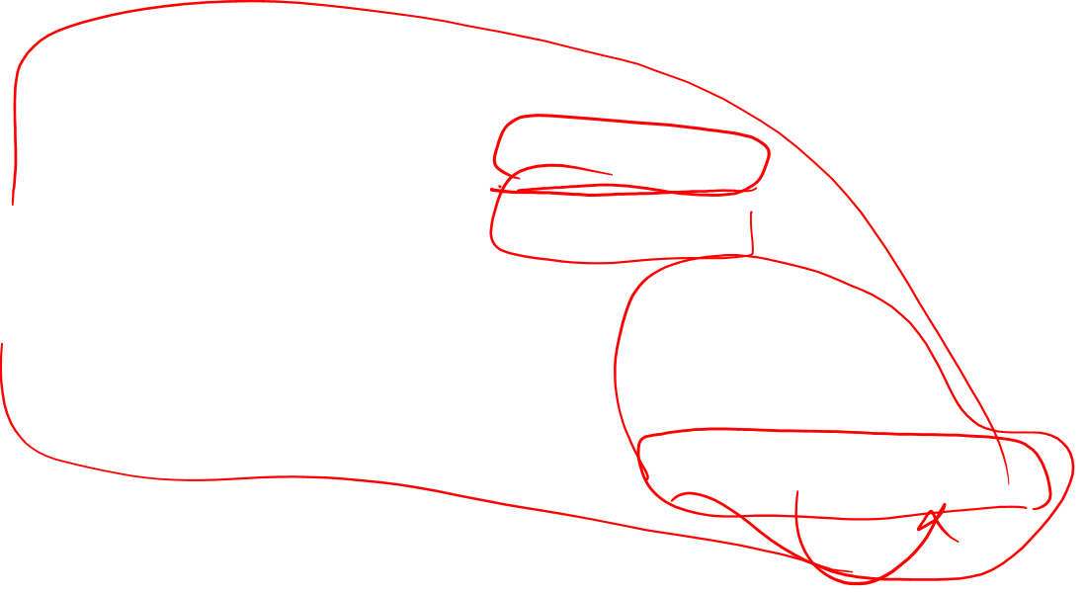
Weighted Min Edit Distance
Initialization:
D(0,0) = 0
D(i,0) = D(i-1,0) + del[x(i)]; 1 < i ≤ N
D(0,j) = D(0,j-1) + ins[y(j)]; 1 < j ≤ M
Recurrence Relation:
D(i-1,j) + del[x(i)]
D(i,j)= min D(i,j-1) + ins[y(j)]
D(i-1,j-1) + sub[x(i),y(j)]
Termination:
D(N,M) is distance

Slide 39
Minimum Edit Distance
Weighted Minimum Edit Distance

